Slide 1
ELB & ASG

Slide 2
Scalability & High Availability Scalability means that an application / system can handle greater loads by adapting. Scalability is the property of a system to handle a growing amount of work by adding resources to the system There are two kinds of scalability: •Vertical Scalability • Horizontal Scalability (= elasticity) Scalability is linked but different to High Availability

Slide 3
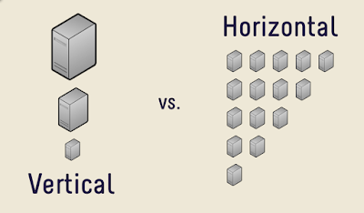

Slide 4
Vertical Scalability
Vertically scalability means increasing the size of the instance
• For example, your application runs on a t2.micro
• Scaling that application vertically means running it on a t2.large
• Vertical scalability is very common for non distributed systems, such as a database.
• RDS, ElastiCache are services that can scale vertically.
• There’s usually a limit to how much you can vertically scale (hardware limit)

Slide 5
Horizontal Scalability
• Horizontal Scalability means increasing the number of instances / systems for your application
• Horizontal scaling implies distributed systems.
This is very common for web applications / modern applications
• It’s easy to horizontally scale thanks the cloud offerings such as Amazon EC2

Slide 6
High Availability
Highly available systems are reliable in the sense that they continue operating even when critical components fail
AWS helps you achieve high availability for cloud workloads, across three different dimensions:
Compute—Amazon EC2 and other services that let you provision computing resources, provide high availability features such as load balancing, auto-scaling and provisioning across Amazon Availability Zones (AZ), representing isolated parts of an Amazon data center.
SQL databases—Amazon RDS and other managed SQL databases provide options for automatically deploying databases with a standby replica in a different AZ.
Storage services—Amazon storage services, such as S3, EFS and EBS, provide built-in high availability options. S3 and EFS automatically store data across different AZs, while EBS enables deployment of snapshots to different AZs.

Slide 7
AWS High Availability for EC2 Instances
Running instances on Amazon EC2, Amazon provides several built-in capabilities to achieve high availability:
Elastic Load Balancing—you can launch several EC2 instances and distribute traffic between them.
Availability Zones—you can place instances in different AZs.
Auto Scaling—use auto-scaling to detect when loads increase, and then dynamically add more instances.

Slide 8
Load balancing
Load balancers are servers that forward internet traffic to multiple servers (EC2 Instances) downstream.
User1 Public Private
User2
User3
EC1
Load Balancers
EC2
EC3

Slide 9
Use Of Load Balancers
Spread load across multiple downstream instances
Expose a single point of access (DNS) to your application
Do regular health checks to your instances
Enforce stickiness with cookies
Provide SSL termination (HTTPS) for your websites
Seamlessly handle failures of downstream instances
High availability across zones
Separate public traffic from private traffic

Slide 10
Elastic Load Balancing
Elastic Load Balancing automatically distributes your incoming traffic across multiple targets, such as EC2 instances, containers, and IP addresses, in one or more Availability Zones
It monitors the health of its registered targets, and routes traffic only to the healthy targets
Elastic Load Balancing scales your load balancer as your incoming traffic changes over time. It can automatically scale to the vast majority of workloads.
Elastic Load Balancing supports the following load balancers:
Application Load Balancers
Network Load Balancers
Classic Load Balancers.
Gateway Load Balancers

Slide 11
Types of load balancer on AWS
AWS has 3 kinds of managed Load Balancers
Classic Load Balancer (v1 - old generation) – 2009
HTTP, HTTPS, TCP
Application Load Balancer (v2 - new generation) – 2016
HTTP, HTTPS, WebSocket
Network Load Balancer (v2 - new generation) – 2017
TCP, TLS (secure TCP) & UDP
“ Recommended to use the newer / v2 generation load balancers as they provide more features “

Slide 12
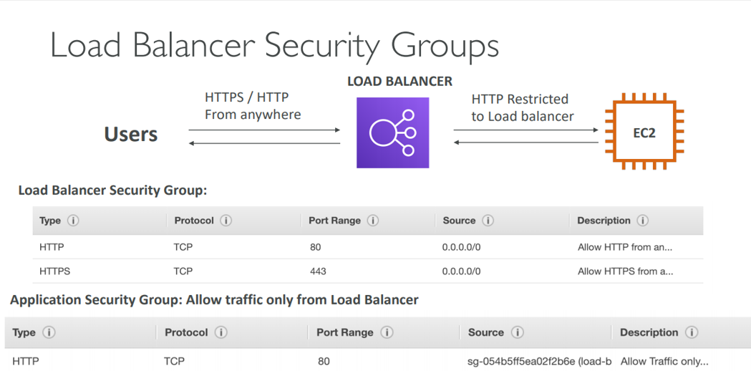

Slide 13
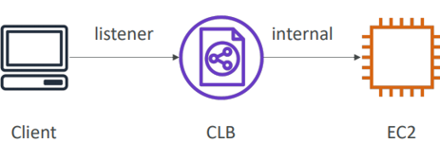
CLASSIC LOAD BALANCER

Slide 14
LISTENER IN LOAD BALANCERS
A listener is a process that checks for connection requests. It is configured with a protocol and a port for front-end (client to load balancer) connections, and a protocol and a port for back-end (load balancer to back-end instance) connections.
Default property of load Balancer
Elastic Load Balancing supports the following protocols:
HTTP
HTTPS (secure HTTP)
TCP
SSL (secure TCP)

Slide 15
Classic Load Balancer makes routing decisions at either the transport layer (TCP/SSL) or the application layer (HTTP/HTTPS)
Classic Load Balancer provides basic load balancing across multiple Amazon EC2 instances and operates at both the request level and connection level.
Classic Load Balancer is intended for applications that are built within the EC2-Classic network.
CLB Supports TCP (Layer 4), HTTP & HTTPS (Layer 7)
Health checks are TCP or HTTP based
Has Fixed hostname ABC.region.elb.amazonaws.com

Slide 16
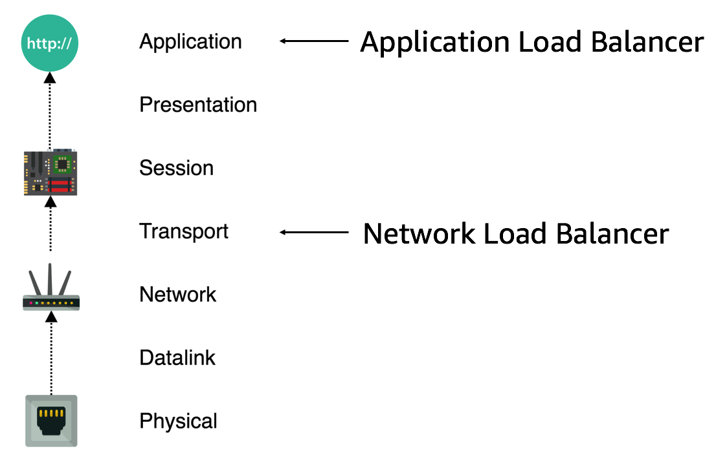

Slide 17
Health Check
The ELB Health Check is used by AWS to determine the availability of registered EC2 instances and their readiness to receive traffic.
Any server that does not return a healthy status is considered unavailable and will not have any traffic routed to it.
The ELB Health Check is configured with a protocol and port number to call on the target instances.
Instances that return a status code which is not within the 200 range or which time out are designated as being unhealthy and will not receive traffic from the ELB
Health Checks are conducted on a period basis, allowing unhealthy instances to recover, and healthy instances to confirm their capacity to continue receiving traffic.

Slide 18
ELB health check Configuration
Ping Target
You have the option to choose the protocol, port and path you would like to target for the health check. Supported protocols include TCP, HTTP, HTTPS and SSL, and you can use any port in the range of 1 to 65535. (The default for a web application would be HTTP on port 80 and a path of /index.html.
Response Timeout
The response timeout is measured in seconds and must fall in the range of two to 60 seconds, with a default of five seconds. Instances are struck with a failed health check if they don’t respond within this period.

Slide 19
Health Check Interval
A health check is conducted every 30 seconds by default. The period between each check can be shortened to every five seconds or extended up to 300 seconds/5 minutes between calls.
Healthy and Unhealthy Thresholds
Threshold counts in place for the number of consecutive health checks which an instance must pass or fail to be marked as healthy or unhealthy respectively. Two successive failures will mark an instance as unhealthy. Ten consecutive passing health checks are required before an unhealthy instance will be marked as healthy again.

Slide 20
Application Load Balancer
• Application load balancers is Layer 7 (HTTP)
• Load balancing to multiple HTTP applications across machines (target groups)
• Load balancing to multiple applications on the same machine (ex: containers)
• Support for HTTP/2 and WebSocket
• Support redirects (from HTTP to HTTPS for example)

Slide 21
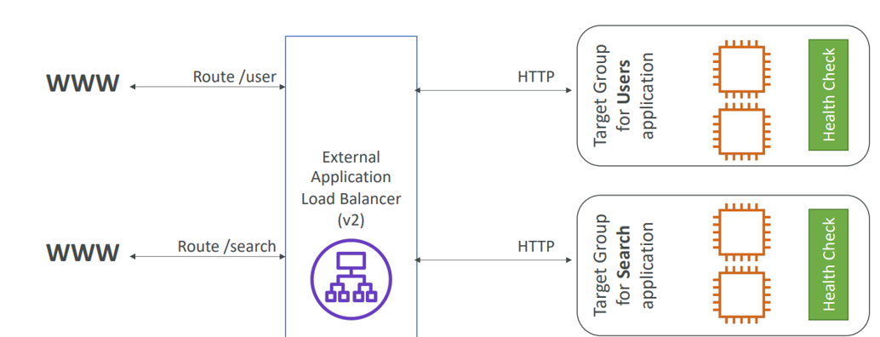
HTTP Based Traffic

Slide 22
Routing tables to different target groups
• Routing based on path in URL (example.com/users & example.com/posts)
• Routing based on hostname in URL (one.example.com & other.example.com) • Routing based on Query String, Headers (example.com/users?id=123&order=false)
• ALB are a great fit for micro services & container-based application (example: Docker & Amazon ECS)
In comparison, we’d need multiple Classic Load Balancer per application

Slide 23
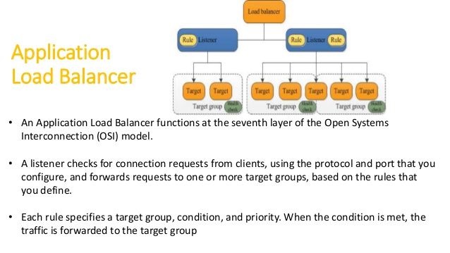

Slide 24
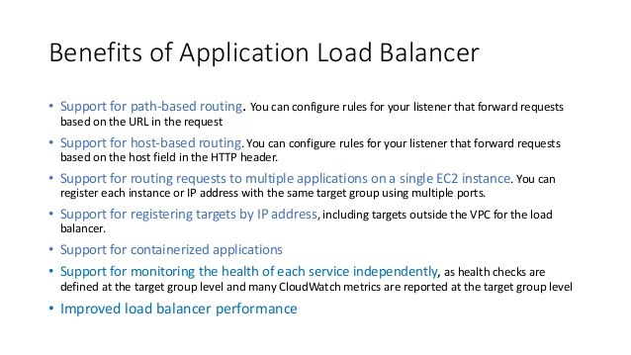

Slide 25
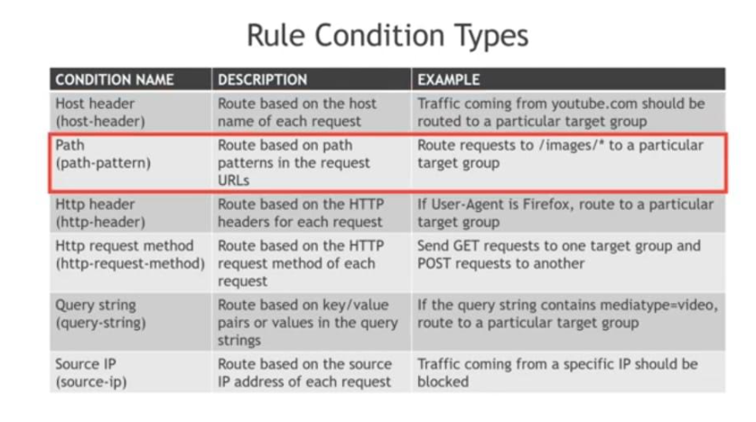

Slide 26
Network Load Balancer
A Network Load Balancer (NLB) works at layer 4 only and can handle both TCP and UDP
It uses static IP addresses and can be assigned Elastic IPs—not possible with ALB and ELB.
Its main feature is that it has a very high performance.
NLB natively preserves the source IP address in TCP/UDP packets; in contrast, ALB and ELB can be configured to add additional HTTP headers with forwarding information, and those have to be parsed properly by your application.
NLB are used for extreme performance, TCP or UDP traffic
Not included in the AWS free tier.
When a load balancer receives a connection request, it selects one target from the target group to assign a default rule.

Slide 27
Load Balancer ALB vs NLB
https://blog.cloudcraft.co/alb-vs-nlb-which-aws-load-balancer-fits-your-needs/#:~:text=The%20ALB%20only%20supports%20HTTP,is%20currently%20your%20only%20choice

Slide 28
Load Balancer Stickiness
• It is possible to implement stickiness so that the same client is always redirected to the same instance behind a load balancer
• This works for Classic Load Balancers & Application Load Balancers • The “cookie” used for stickiness has an expiration date you control
• Use case: make sure the user doesn’t lose his session data
• Enabling stickiness may bring imbalance to the load over the backend EC2 instances

Slide 29
Cross Zone Load Balancing
With Cross Zone Load Balancing: each load balancer instance distributes evenly across all registered instances in all AZ
Otherwise, each load balancer node distributes requests evenly across the registered instances in its Availability Zone only

Slide 30
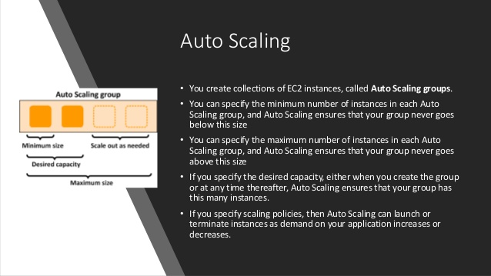

Slide 31
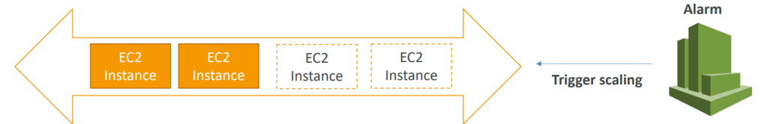
Auto Scaling Alarms
• It is possible to scale an ASG based on CloudWatch alarms
• An Alarm monitors a metric (such as Average CPU)
• Metrics are computed for the overall ASG instances
• Based on the alarm:
• We can create scale-out policies (increase the number of instances)
• We can create scale-in policies (decrease the number of instances)

Slide 32
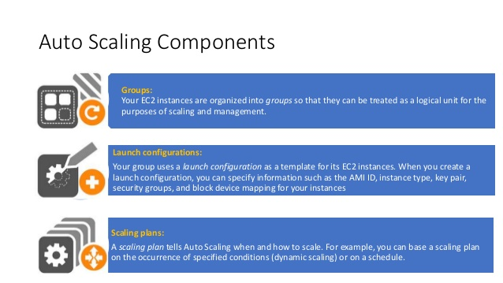

Slide 33
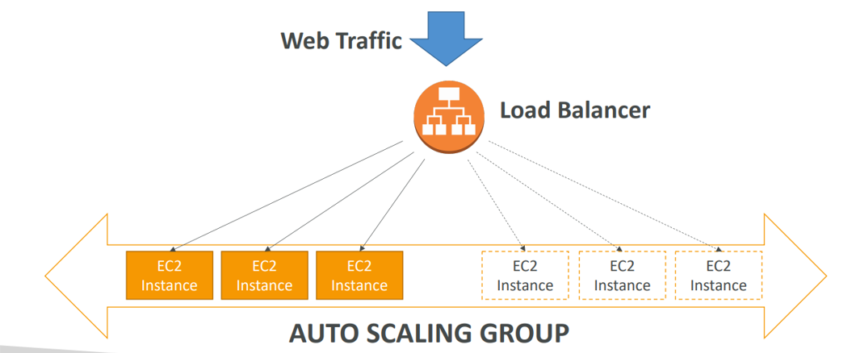
Auto Scaling Group With Load Balancer

Slide 34
Auto Scaling Groups – Scaling Policies
Target Tracking Scaling
Most simple and easy to set-up
Example: Set the average ASG CPU to stay at around 40%
Simple / Step Scaling
When a CloudWatch alarm is triggered (example CPU > 70%), then add 2 units
When a CloudWatch alarm is triggered (example CPU < 30%), then remove 1
Scheduled Actions
Anticipate a scaling based on known usage patterns
Example: increase the min capacity to 10 at 5 pm on Fridays

Slide 35
Cooldown period
The cooldown period helps to ensure that your Auto Scaling group doesn't launch or terminate additional instances before the previous scaling activity takes effect.
If your application is scaling up and down multiple times each hour, modify the Auto Scaling Groups cool-down timers and the CloudWatch Alarm Period that triggers the scale in
If the default cooldown period of 300 seconds is too long—you can reduce costs by applying a scaling-specific cooldown period of 180 seconds to the scale-in policy.

Slide 36
